Slide 1




Unveiling Insights:
Exploring Apple Store App Data using SQL
presentation by Purva Masurkar
GITHUB LINK OF THE PROJECT
Data Analysis | SQL

Slide 2


INTRODUCTION
In a digital ecosystem brimming with mobile applications, understanding user preferences and market dynamics is paramount for app developers to thrive. This technical piece delves into an insightful journey of analyzing Apple Store app data, aiming to unearth actionable recommendations for stakeholders, particularly mobile app developers and aspiring entrepreneurs.
GITHUB LINK OF THE PROJECT

Slide 3

STEPS FOR ANALYSIS
STAKEHOLDER IDENTIFICATION
EXPLORATORY DATA ANALYSIS
ANALYSIS AND RECOMMENDATIONS
Primarily mobile app developers and aspiring app entrepreneurs, were identified for whom the analysis would be tailored.
A meticulous examination of the dataset ensued, with a focus on identifying any missing values or duplicates to ensure data integrity and reliability.
Six recommendations were made after the analysis process mostly with respect to the user ratings.
GITHUB LINK OF THE PROJECT

Slide 4
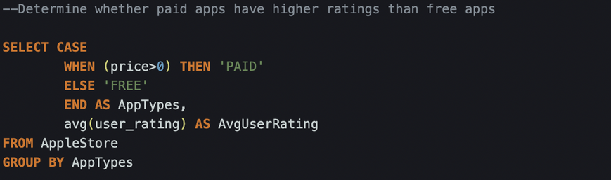
RECOMMENDATION 1
PAID APPS AND CUSTOMER RATINGS
The analysis revealed a notable trend: paid apps garner higher customer ratings than their free counterparts, signalling potential opportunities for revenue generation and enhanced user satisfaction.
GITHUB LINK OF THE PROJECT

Slide 5
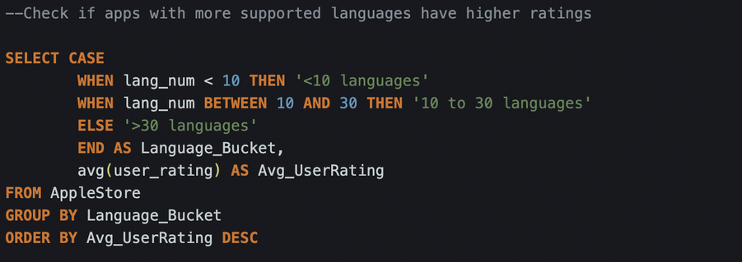
RECOMMENDATION 2
LANGUAGE SUPPORT AND APP RATINGS
Apps supporting a diverse range of languages, particularly within the 10-30 language bracket, exhibited higher ratings. This underscores the importance of catering to a global audience through multilingual support.
GITHUB LINK OF THE PROJECT

Slide 6
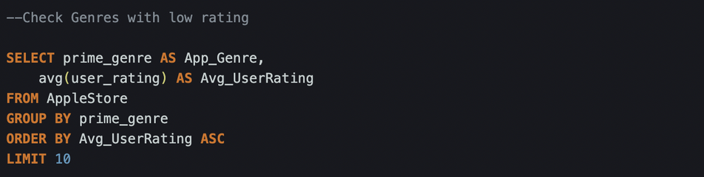
RECOMMENDATION 3
GENRE-SPECIFIC RATINGS
Contrasting trends emerged within different app genres. Finance and book app categories, for instance, exhibited relatively lower ratings, suggesting potential areas for improvement or market repositioning.
GITHUB LINK OF THE PROJECT

Slide 7
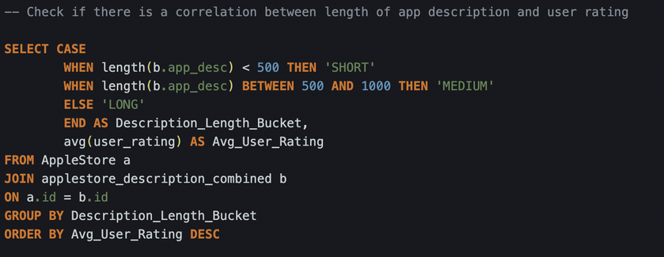
RECOMMENDATION 4
DESCRIPTION LENGTH & USER ENGAGEMENT
An intriguing finding surfaced concerning app descriptions: apps with longer descriptions tended to enjoy better ratings, indicating a correlation between comprehensive app information and user engagement.
GITHUB LINK OF THE PROJECT

Slide 8
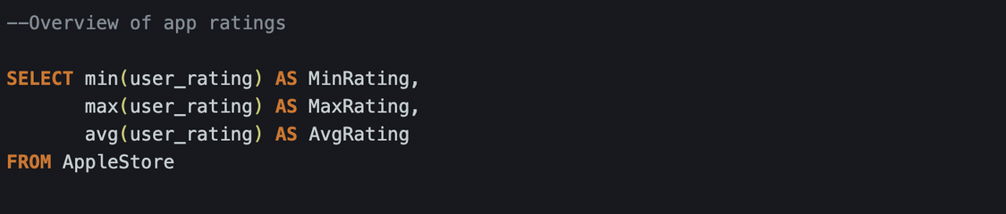
RECOMMENDATION 5
THRESHOLD FOR NEW APPS
In light of the analysis, a recommended threshold for aspiring app developers surfaced: aiming for a minimum rating of 3.5 could bolster the initial success and user acceptance of new apps.
GITHUB LINK OF THE PROJECT

Slide 9
RECOMMENDATION 6
GENRE-BASED COMPETITION
Lastly, the analysis shed light on the competitive landscape within the Apple Store, particularly within the games and entertainment genres, where high competition levels were observed. This underscores the necessity for strategic differentiation and innovation to stand out amidst the crowd.
GITHUB LINK OF THE PROJECT

Slide 10

CONCLUSION
By leveraging these findings, app developers and entrepreneurs can strategically position their offerings, optimize user experiences, and ultimately drive success in the ever-evolving realm of mobile applications.
GITHUB LINK OF THE PROJECT

